Slide 1
Deep Learning and Cognitive Computing
Slide in this Presentation Contain Hyperlinks. JAWS users should be able to get a list of links by using INSERT+F7
Notes:
If this PowerPoint presentation contains mathematical equations, you may need to check that your computer has the following installed:
1) Math Type Plugin
2) Math Player (free versions available)
3) NVDA Reader (free versions available)

Slide 2
Learning Objectives
Learn what deep learning is and how it is changing the world of computing
Know the placement of deep learning within the broad family of AI learning methods
Understand how traditional “shallow” artificial neural networks (ANN) work
Become familiar with the development and learning processes of ANN
Develop an understanding of the methods to shed light into the ANN black box
Know the underlying concept and methods for deep neural networks
Become familiar with different types of deep learning methods
Become familiar with the computer frameworks for implementing deep learning
Notes:
Slide 2 is list of textbook LO numbers and statements

Slide 3
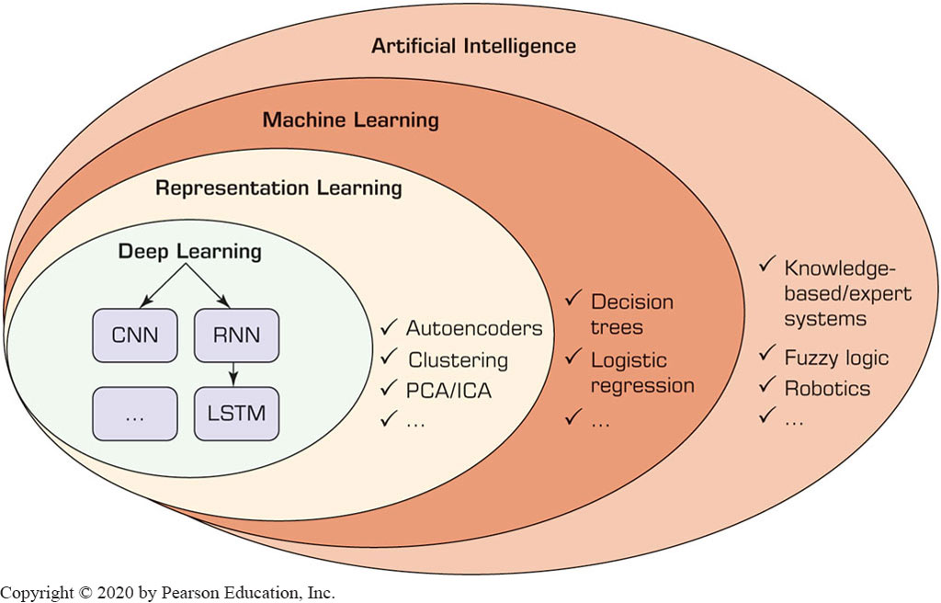
Introduction to Deep Learning
The placement of Deep Learning within the overarching A I-based learning methods

Slide 4
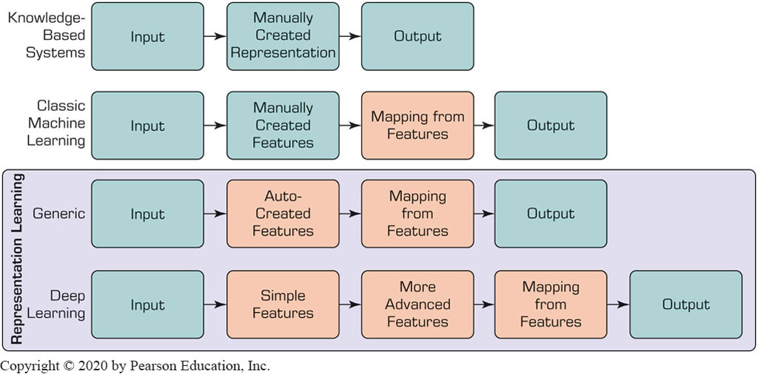
Introduction to Deep Learning
Differences between Classic Machine-Learning Methods and Representation Learning/Deep Learning

Slide 5
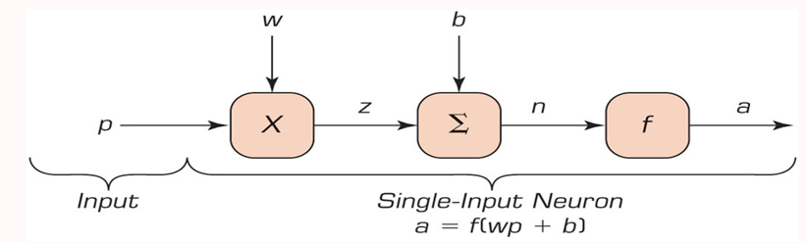
Basics of “Shallow” Learning
Artificial Neural Networks – abstractions of human brain and its complex biological network of neurons
Neurons = Processing Elements (P E s)
Single-input and single-output neuron/P E

Slide 6
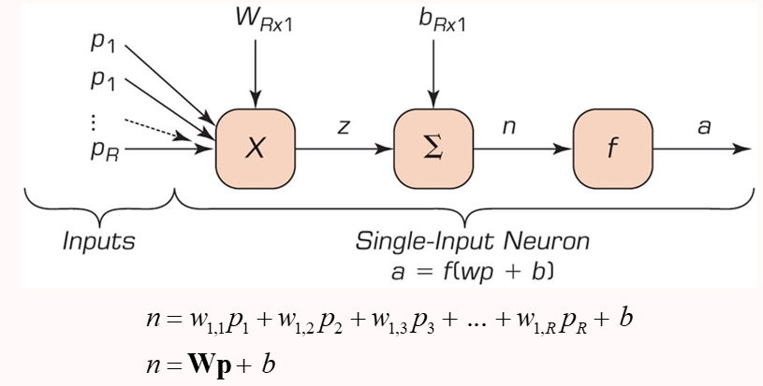
Basics of “Shallow” Learning
Typical multiple-input neuron with R individual inputs

Slide 7
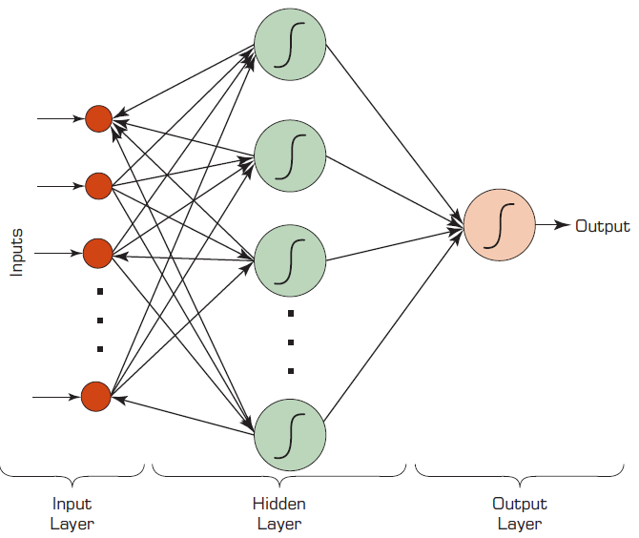
Basics of “Shallow” Learning
Typical Neural Network with three layers and eight neurons

Slide 8
Elements of an Artificial Neural Network
Processing element (P E)
Network structure
Hidden layer(s)
Input
Output
Connection weights
Summation function
Transfer function

Slide 9
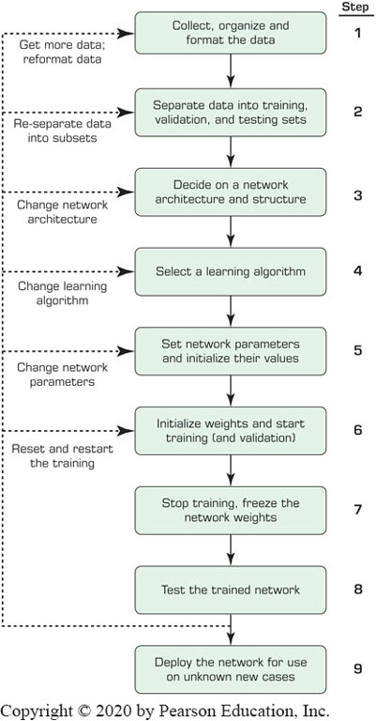
Process of Developing Neural-Network Based Systems
A process with constant feedbacks for changes and improvements!

Slide 10
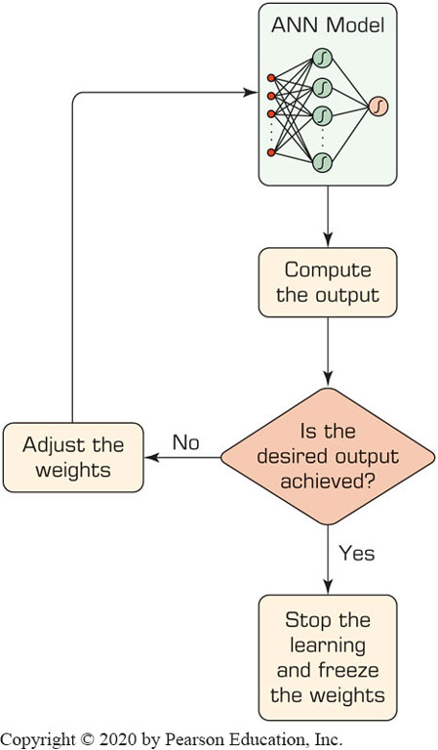
Learning Process in A N N
Compute temporary outputs.
Compare outputs with desired targets.
Adjust the weights and repeat the process.

Slide 11
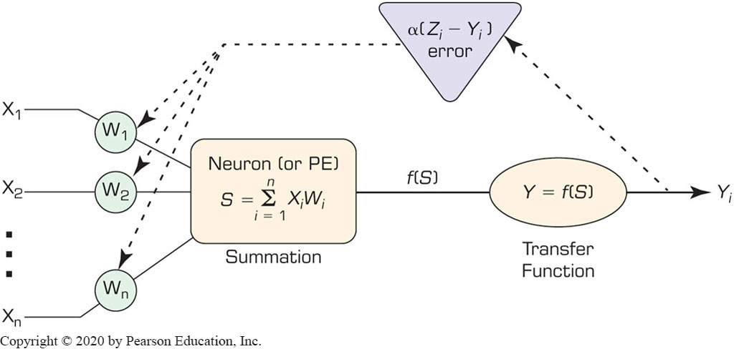
Backpropagation for A N N Training
Initialize weights with random values
Read in the input vector and the desired output
Compute the actual output via the calculations
Compute the error.
Change the weights by working backward

Slide 12
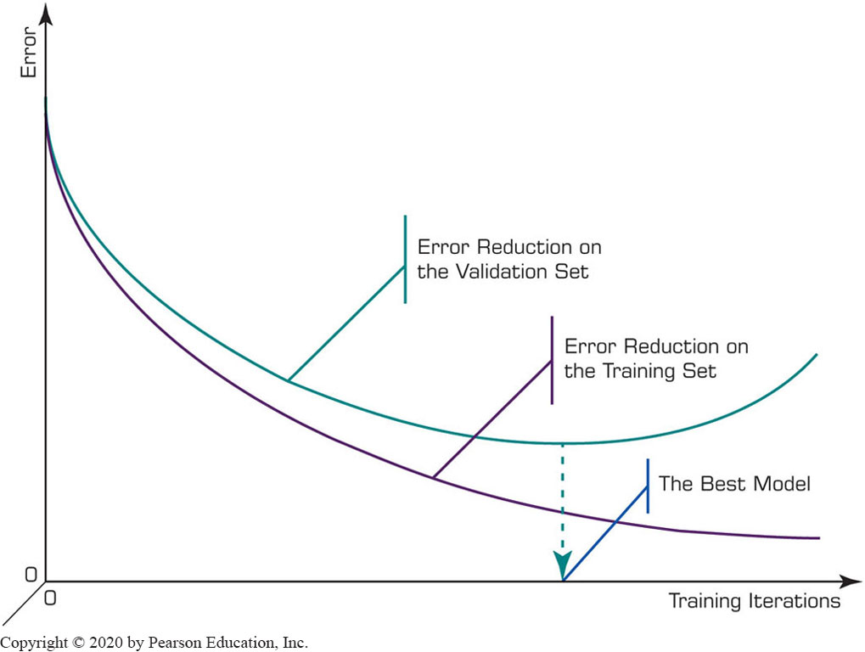
Backpropagation for A N N Training
Illustration of the Overfitting in A N N

Slide 13
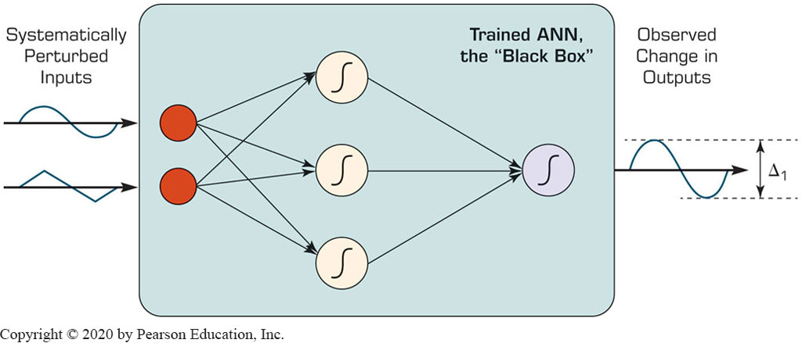
Illuminating the Black Box of A N N
A N N are typically known as black boxes
Sensitivity analysis can shed light to the black-box

Slide 14
Deep Neural Networks
Deep: more hidden layers
In addition to C P U, it also uses G P U
With programming languages like C U D A by N V I D I A
Needs large datasets
Deep learning uses tensors as inputs
Tensor: N-dimensional arrays
Image representation with 3-D tensors
There are different types and capabilities of Deep Neural Networks for different tasks/purposes

Slide 15
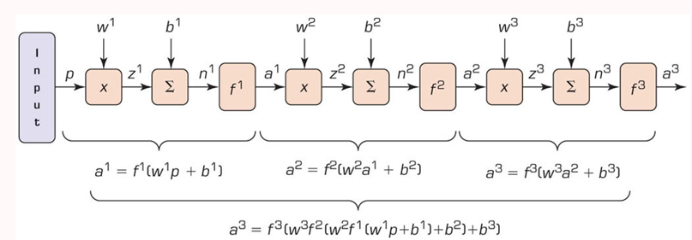
Deep Neural Networks
Feedforward Multilayer Perceptron (M L P)-Type Deep Networks
Most common type of deep networks
Vector Representation of the First Three Layers in a Typical M L P Network.

Slide 16
Convolutional “Deep” Neural Networks
Most popular M L P-base D L method
Used for image/video processing, text recognition
Has at least one convolution weight function
Convolutional layer
Convolutional layer → Polling (sub-sampling)
Consolidating the large tensors into one with a smaller size-and reducing the number of model parameters while keeping only the important features
There can be different types of polling layers

Slide 17
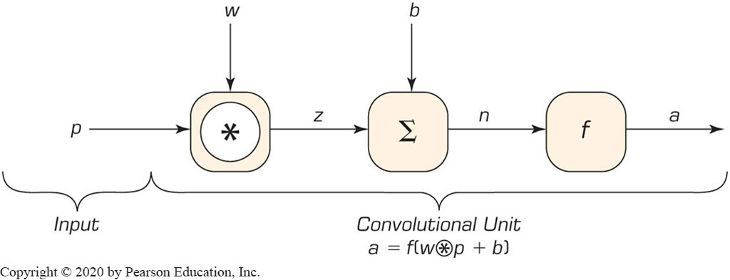
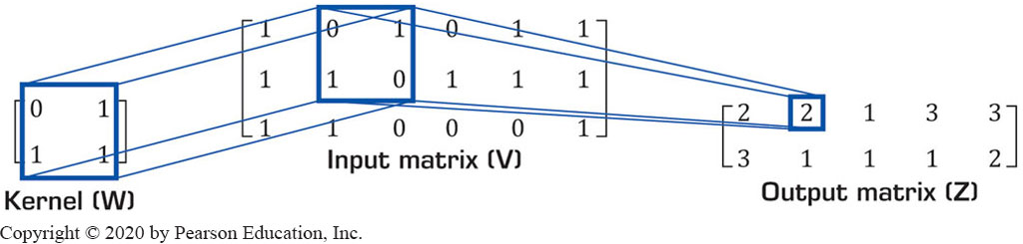
Convolution Function
Typical Convolutional Network Unit
Convolution of a 2 x 2 Kernel by a 3 x 6 Input Matrix

Slide 18
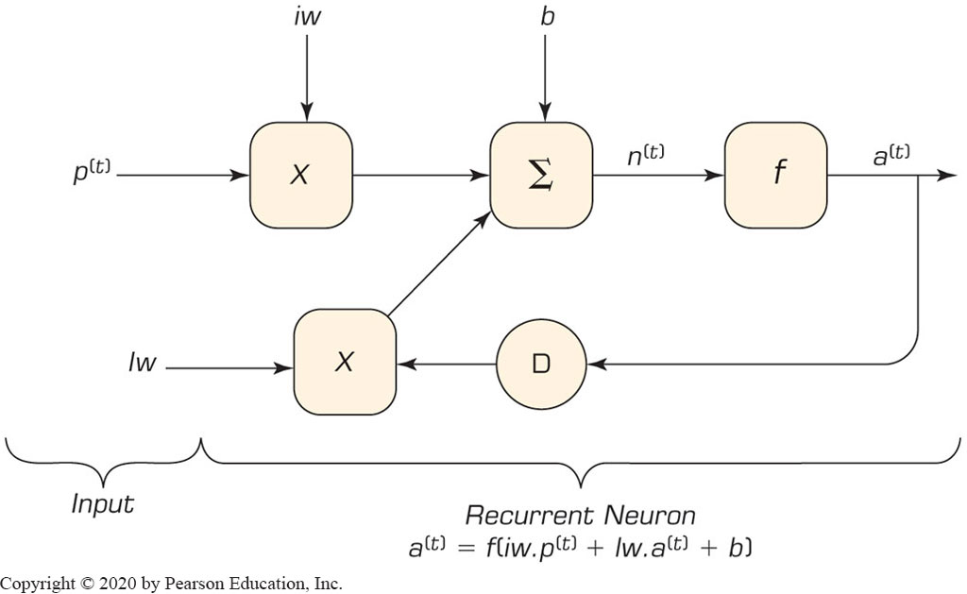
Recurrent Neural Networks (R N N)
R N N designed to process sequential inputs
Typical recurrent unit

Slide 19
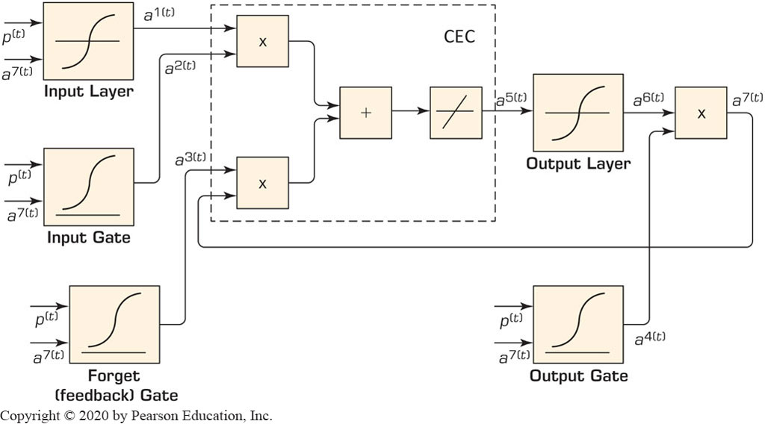
Long Short-Term Memory (L S T M)
L S T M is a variant of R N N
In a dynamic network, the weights are called the long-term memory while the feedbacks role is the short-term memory
Typical Long Short-Term Memory (L S T M) Network Architecture

Slide 20
Deep Learning Frameworks
Torch (http://www.torch.ch)
M L with G P U
Caffe (caffe.berkeleyvision.org)
Facebook’s improved version (www.caffe2.ai)
TensorFlow (www.tensorflow.org)
Google - Tensor Processing Units (T P U s)
Theano (deeplearning.net/software/theano)
Deep Learning Group at the University of Montreal
Keras (keras.io)
Application Programming Interface

Slide 21
Cognitive Computing
Systems that use mathematical models to emulate (or partially simulate) the human cognition process to find solutions to complex problems and situations where the potential answers can be imprecise
How does cognitive computing work?
Adaptive
Interactive
Iterative and stateful
Contextual
Data mining
Pattern recognition
Deep learning
NLP
Mimic the way the human brain works

Slide 22
Cognitive Computing
Characteristics | Cognitive Computing | Artificial Intelligence (AI)
Technologies Used | Machine learning Natural language processing Neural networks Deep learning Text mining Sentiment analysis | Machine learning Natural language processing Neural networks Deep learning
Capabilities Offered | Simulate human thought processes to assist humans in finding solutions to complex problems | Find hidden patterns in a variety of data sources to identify problems and provide potential Solutions
Purpose | Augment human capability | Automate complex processes by acting like a human in certain situations

